Slide 1
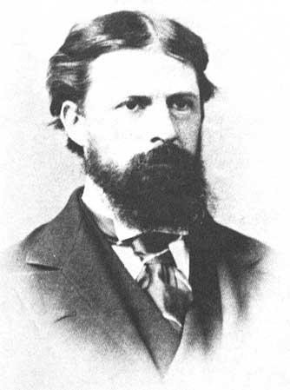
CHARLES PEIRCE DEFINITIONS

Slide 2
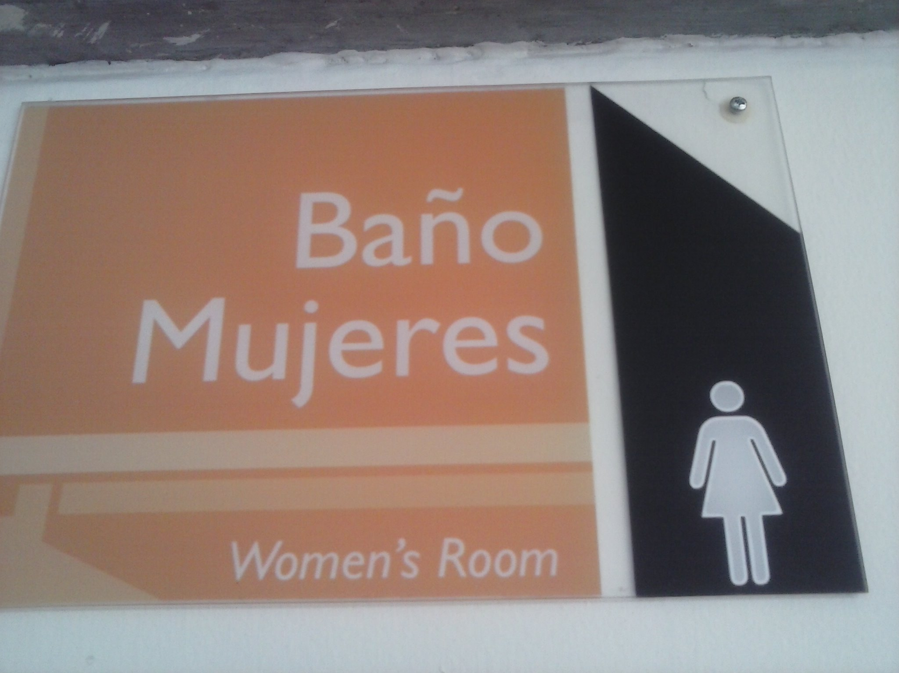
SIGN
A sign is a triad, that is compoused by 3 elements Reprentamen, object and interpretan. In this picture we can see that the representament is the Word Baño Mujeres, the object is the idea and the interpretant is the Baño Mujeres translate to the English. Of this way the unión of this 3 elements are a sign.

Slide 3
REPRESENTAMEN
Peirce defined the representamen as something that enters intorelation with its object. Is the representation of somethig but it’s not a faithful representation. So this Word represent the sports in an intangible way.

Slide 4
OBJECT
The object can never be identical to the ‘real’ object, but is a representation too. In this example we can see the representation of the word sports but its not the real object.

Slide 5
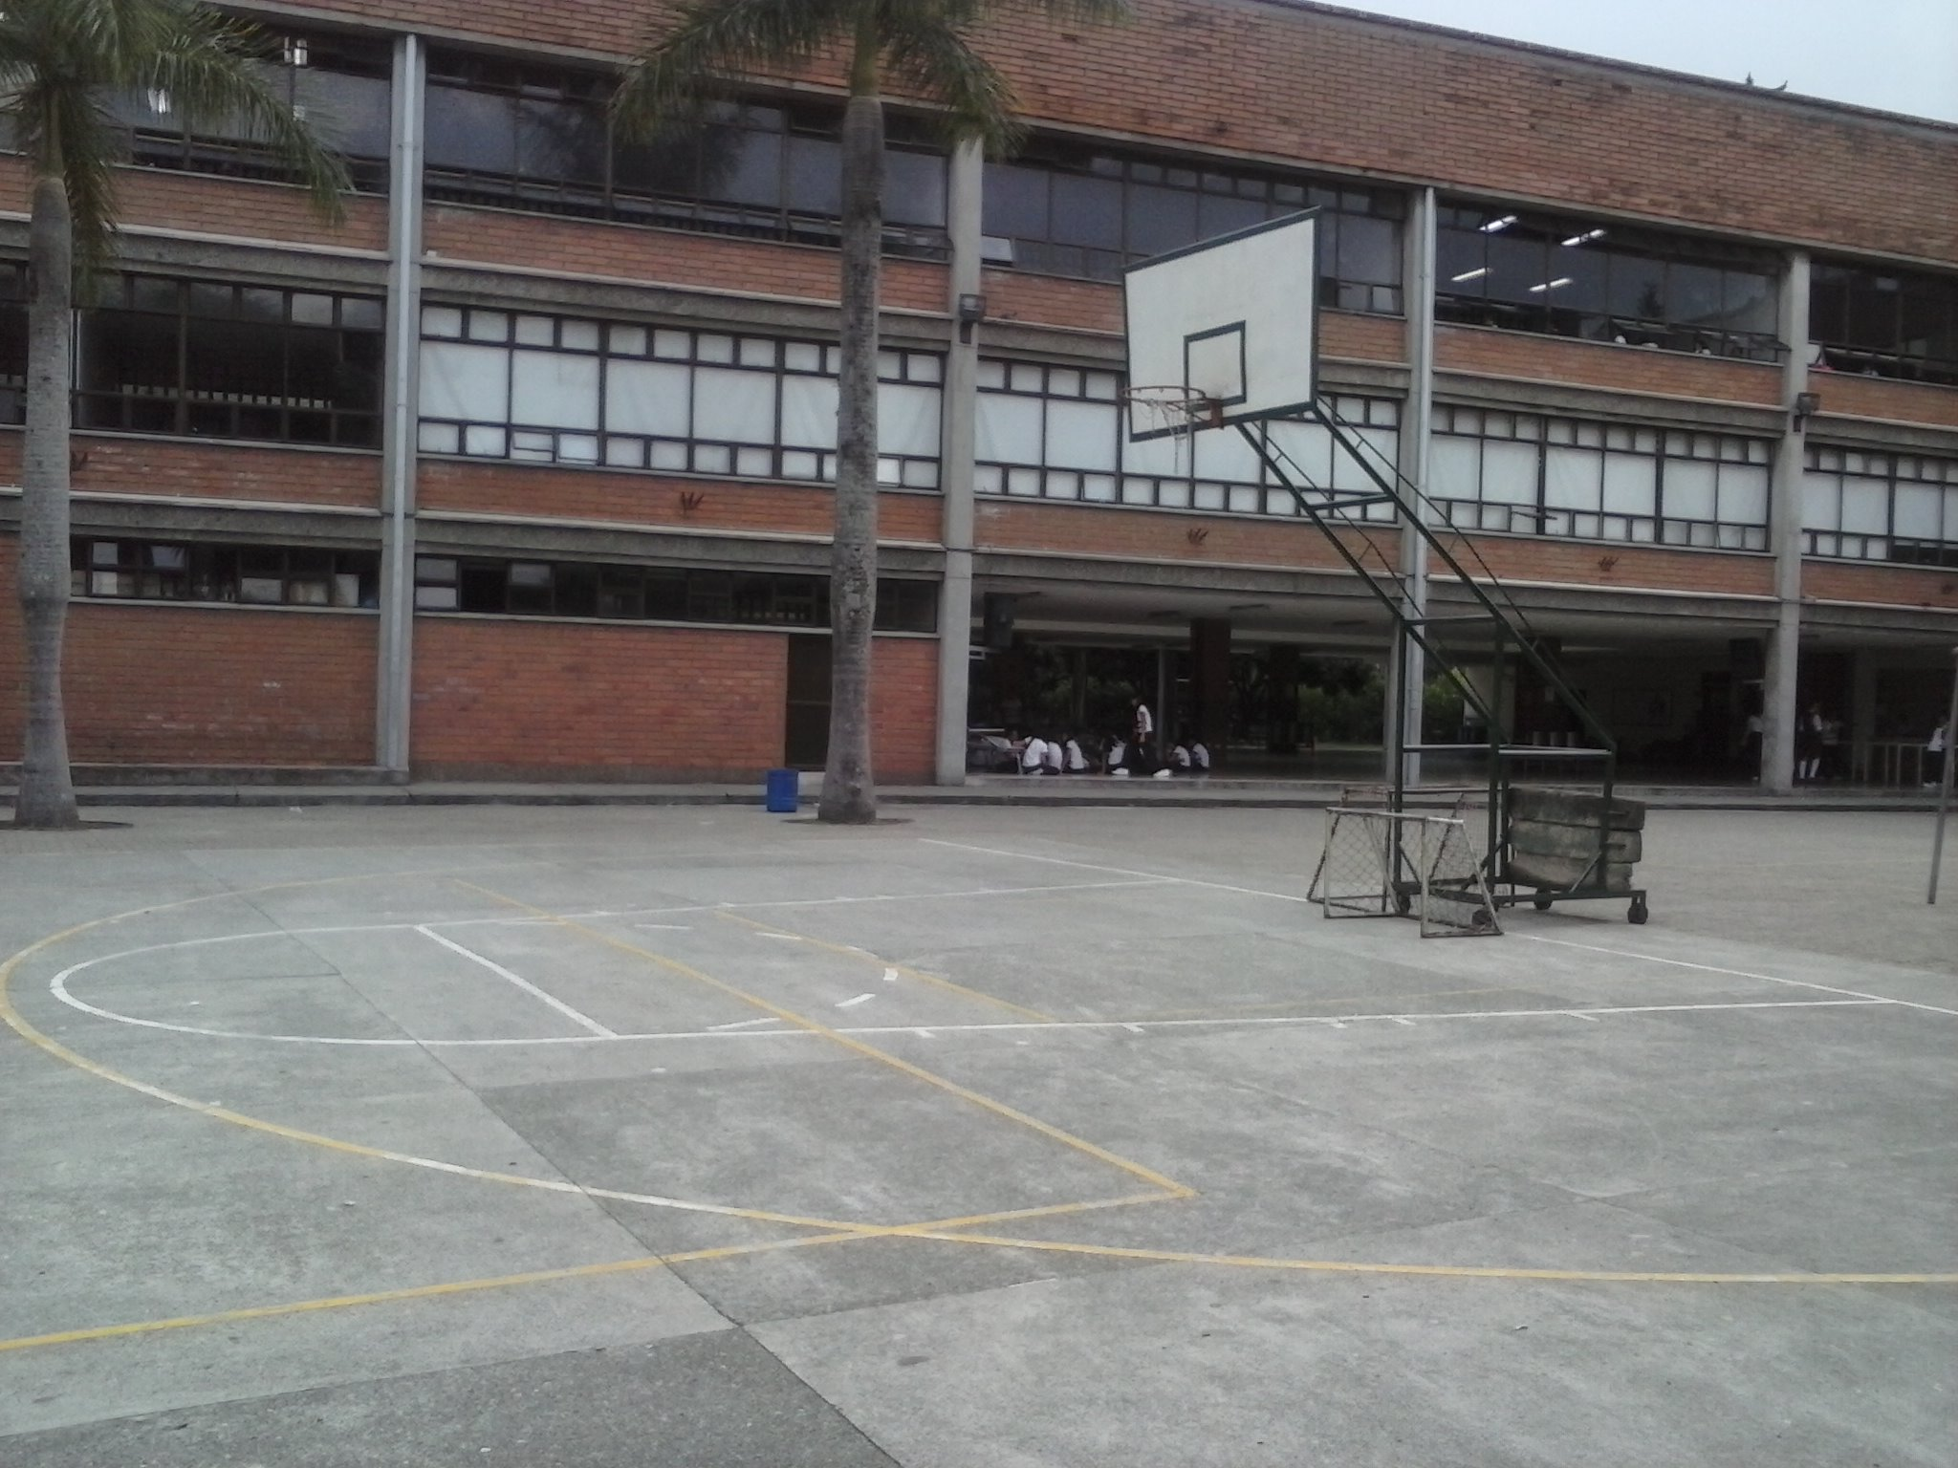
INTERPRETAN
The interpretan is other sign, other representation of the sign and it refers to the same object that the representamen. In the example we can do a integration of the representament and the object and we can asimilate its’ use.

Slide 6
Other aspect of the interpretant is the capacity to translate a Word, here the interpretant have to think and translate the Word in an other language.

Slide 7
ICON
Other aspect that mentioned Peirce is the Icon, this is similar to the object.

Slide 8
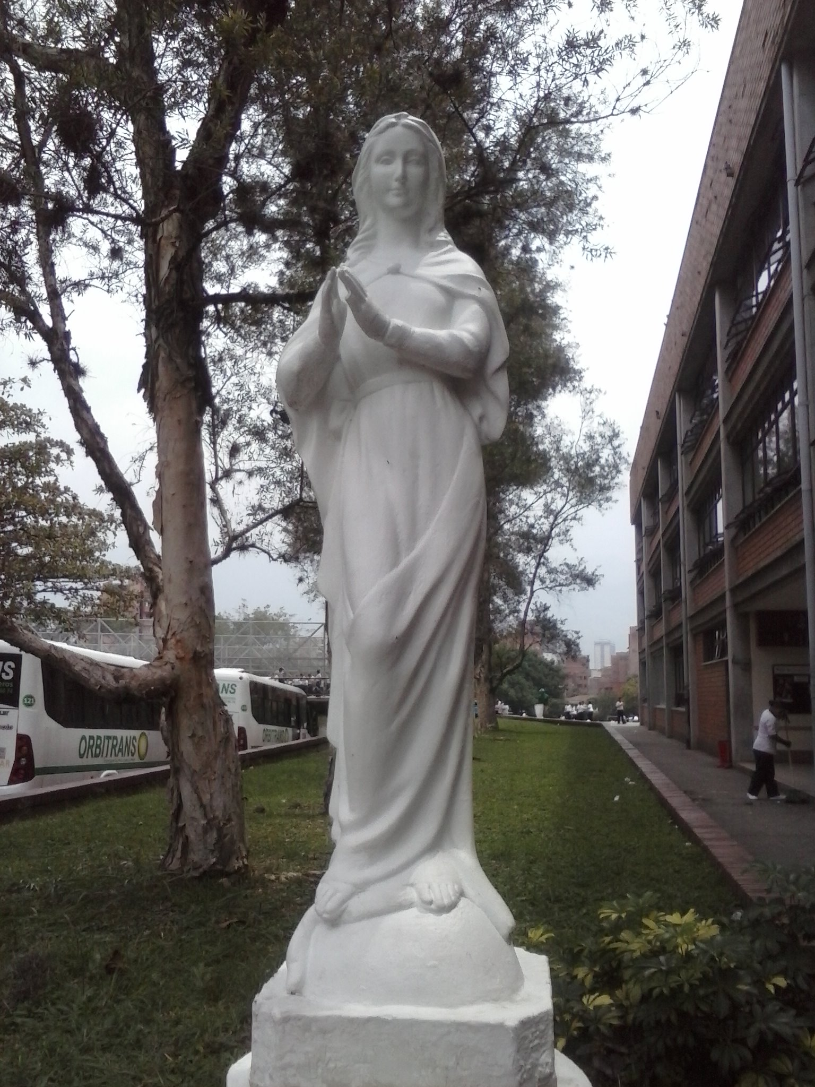

Slide 9
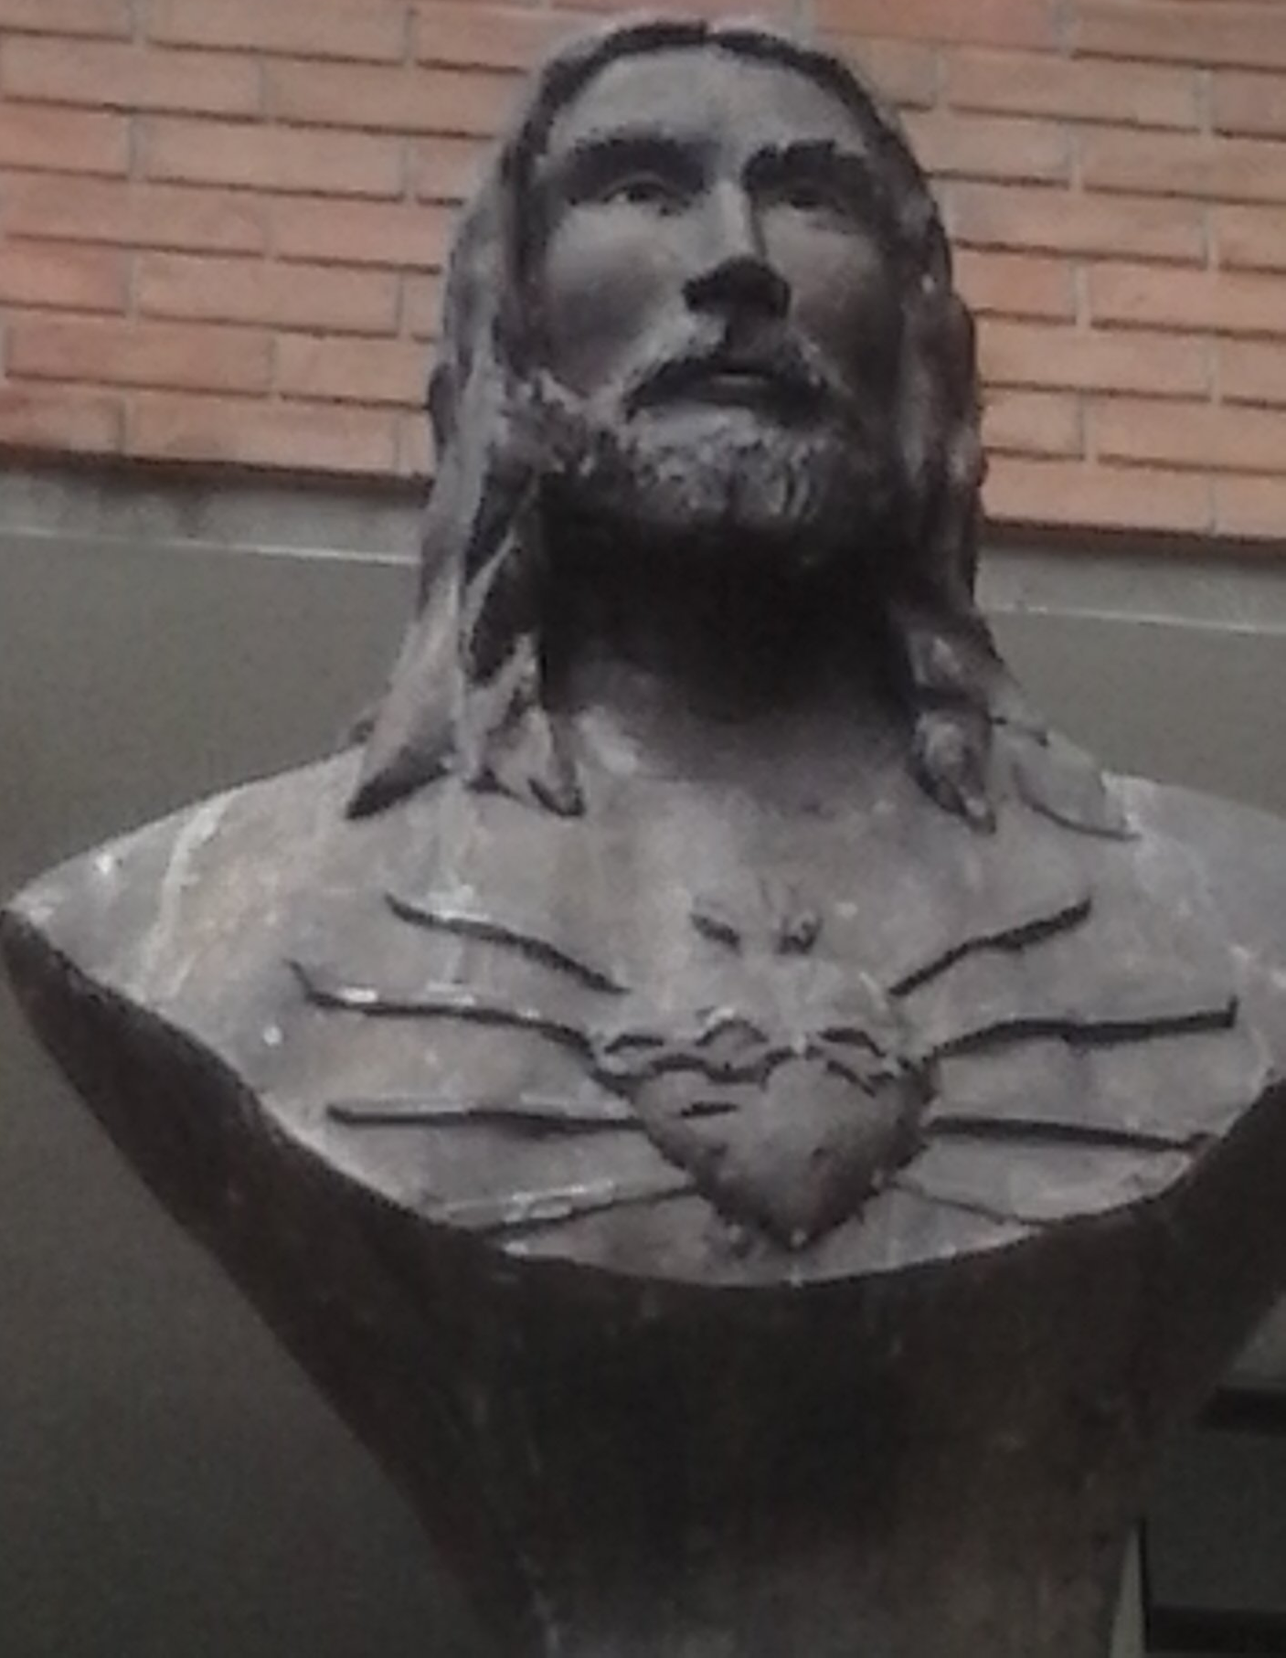
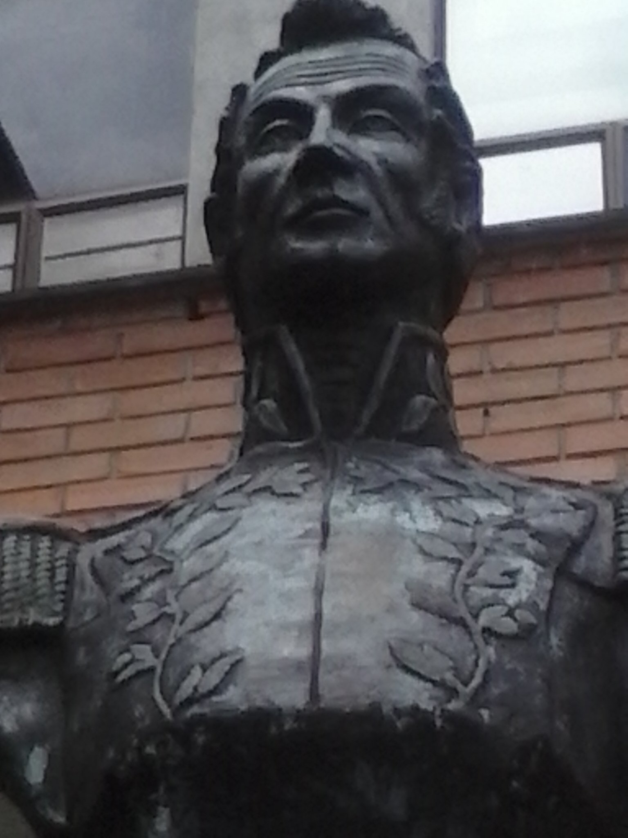

Slide 11
INDEX
The Index is not similar to the object but is related. Here we can see that happened something but this is not the object directly.

Slide 12
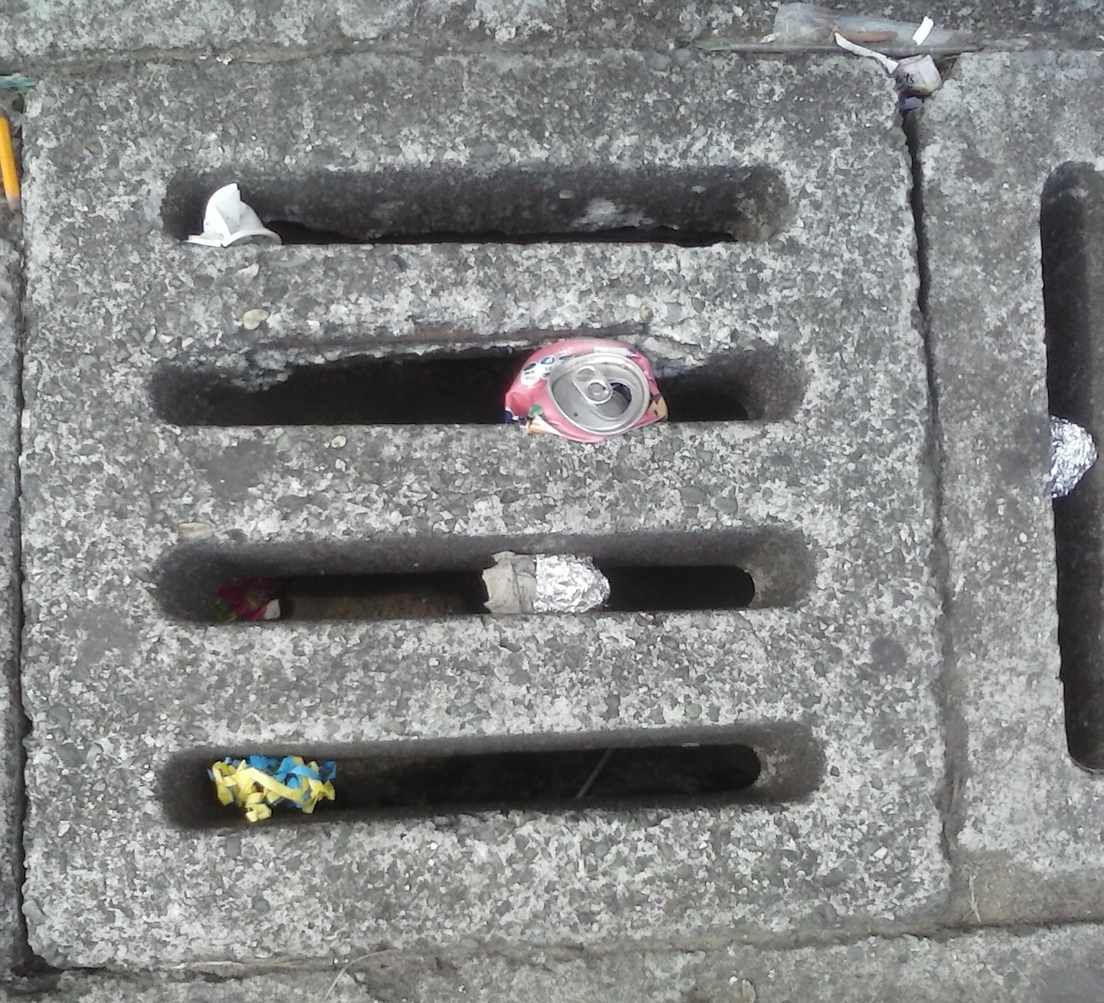
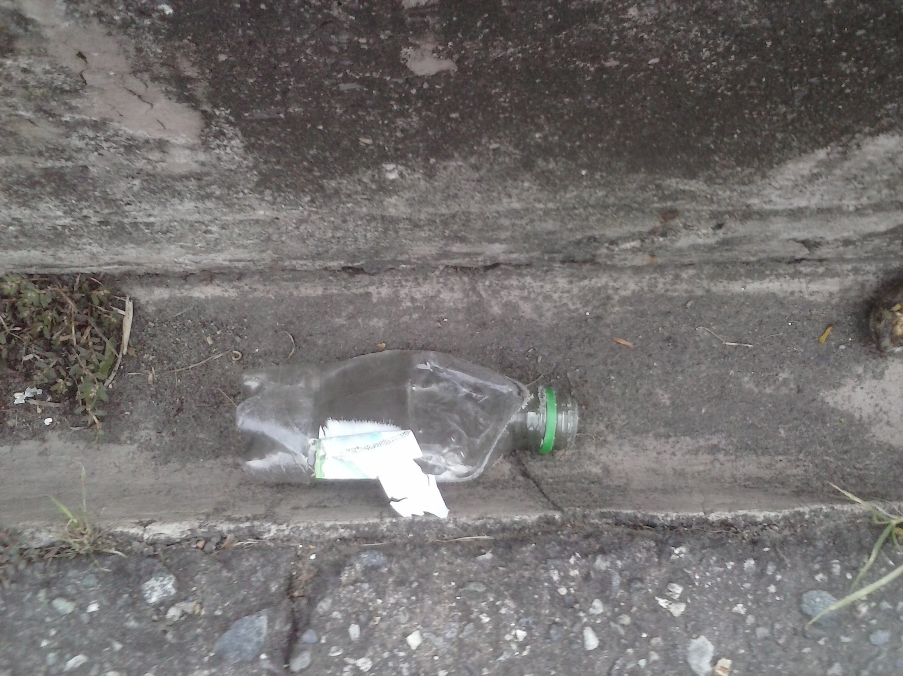

Slide 13
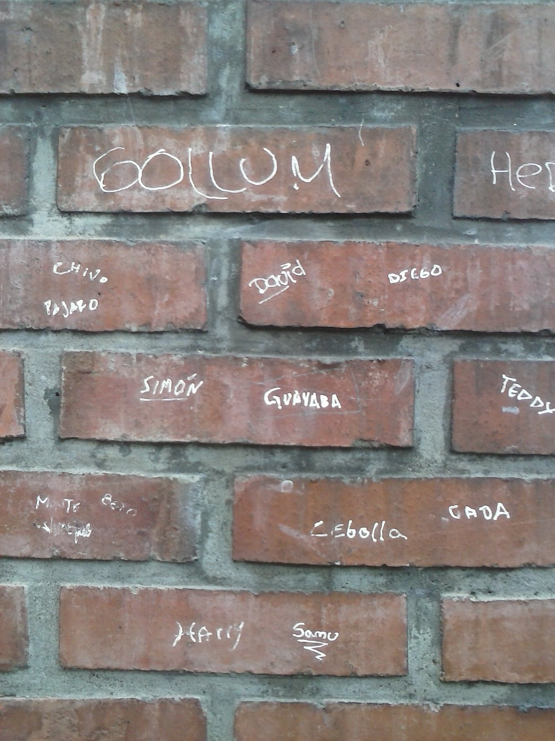

Slide 14
SYMBOL
A symbol is a law or convention. Here is the Virgin Mary, but we could consider an Symbol because at the same time its relates to divinity, purity and other.

Slide 16
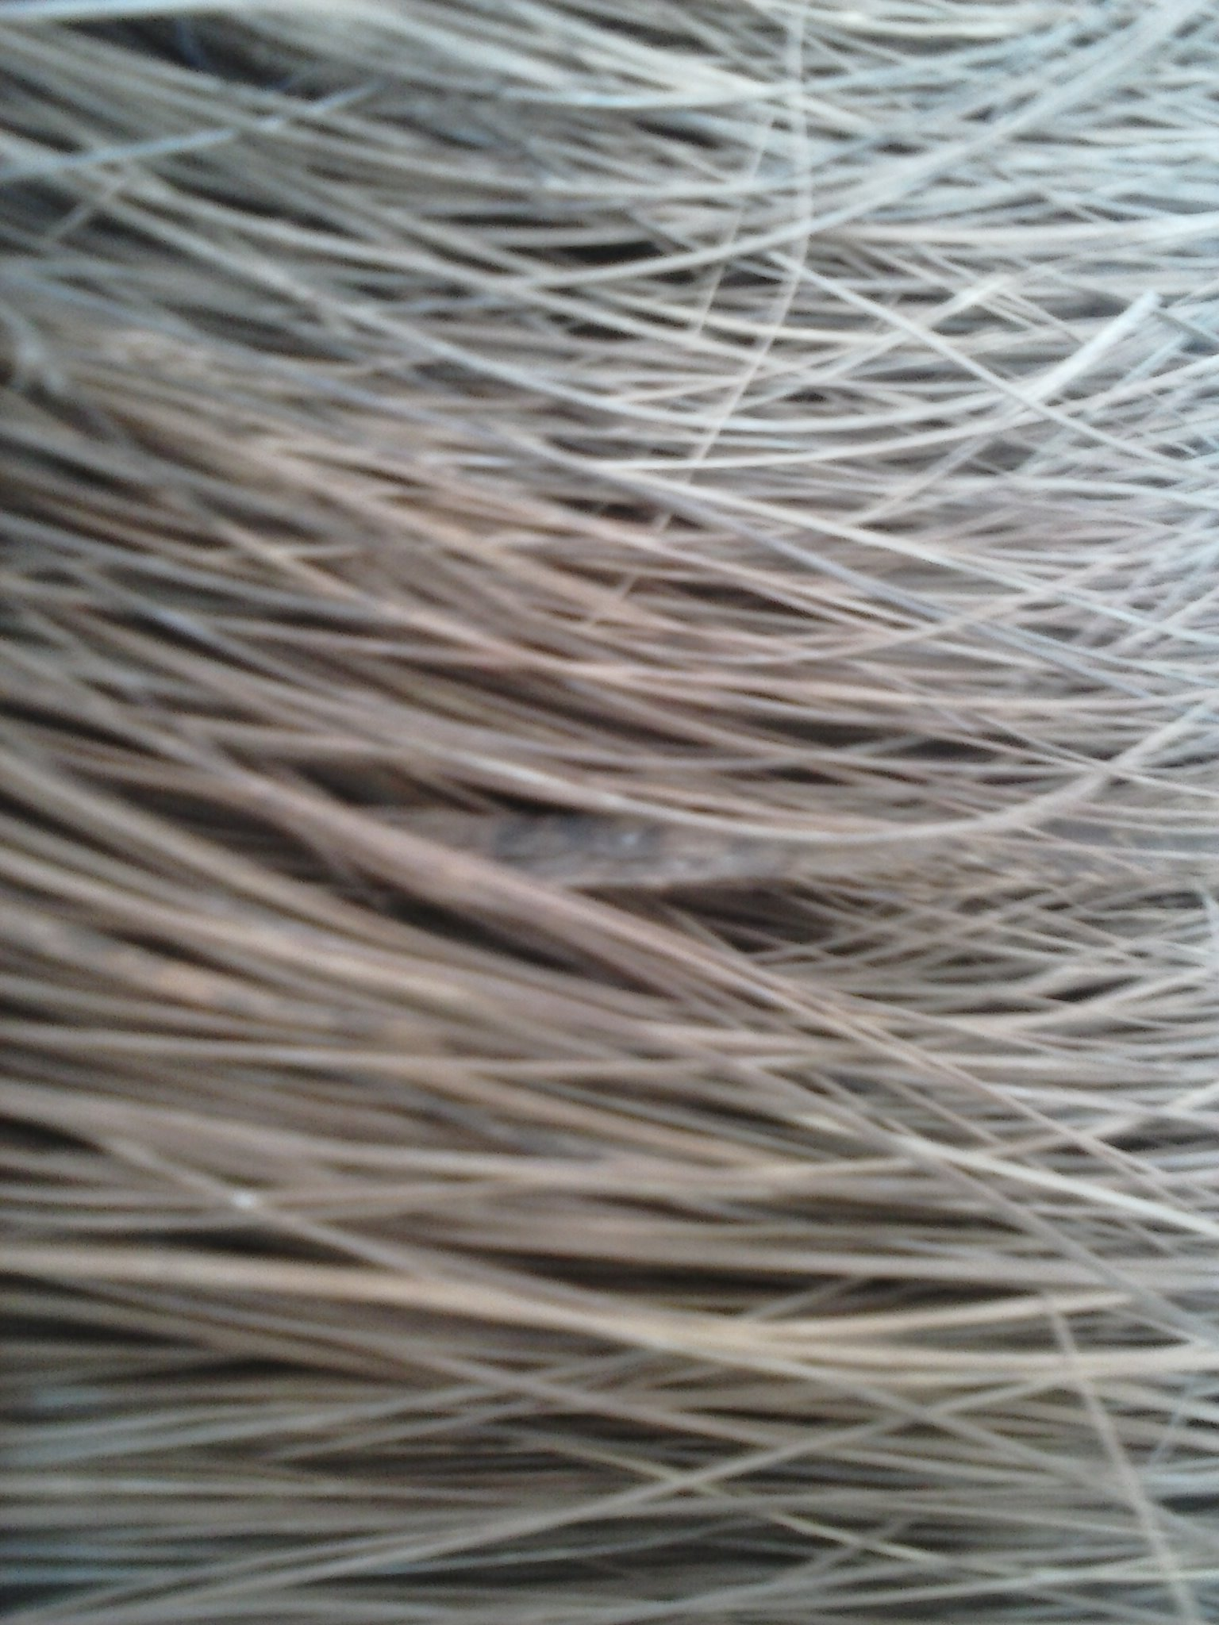
FIRSTNESS
The firstness involves considering something as it is. Linked the ideas and possibilities, here we only feel. In this image we can see but we can imagen what it is.
Then we have to link that we are see and think what is it, here occurred the secondness. We could considered that it’s a hair or other thing.

Slide 17
SECONDNESS
Secondness considered something as is it but in relation whit other, is the reaction. Here we could consider that the last image could be a broom.

Slide 18
THIRDNESS
Thirdness makes possible the law. Connect the cualities with we perceive, the thinking. Here we think about the cualities and uses of the broom.

